Slide 1
Mission: “To Empower Youth To Win in Every Area of Their Lives”
Challenges of Year 2017 - Highlights from Year 2019
Address: 607 McSwain Street – Hattiesburg
East Jerusalem Neighborhood Community

Slide 2
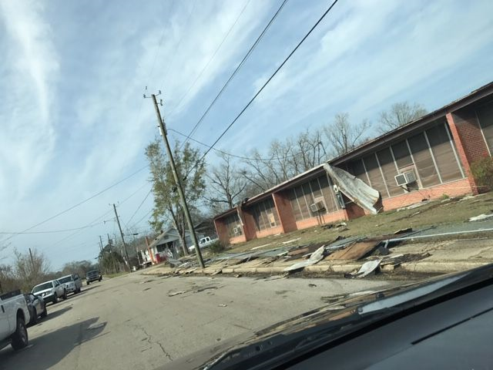
Where We Came From….Challenges of Year 2017
Damage from EF3 Tornado of January 21, 2017

Slide 3
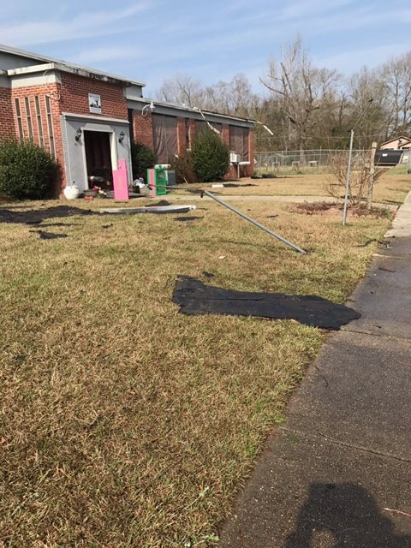
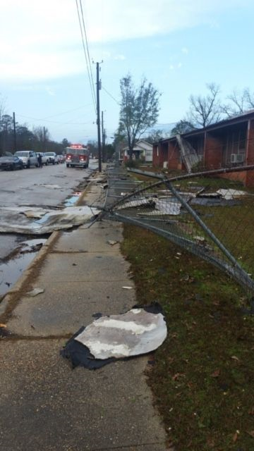
Damage from EF3 Tornado of January 21, 2017

Slide 4
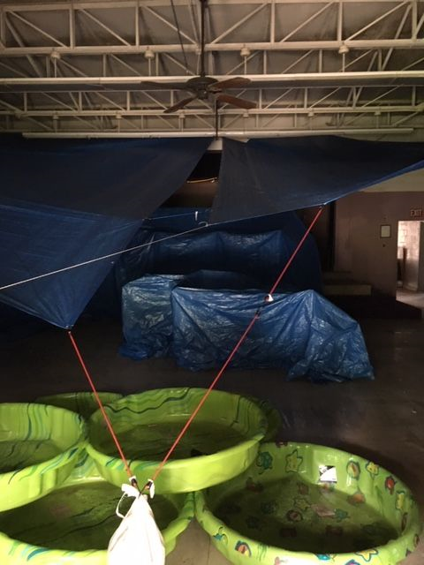
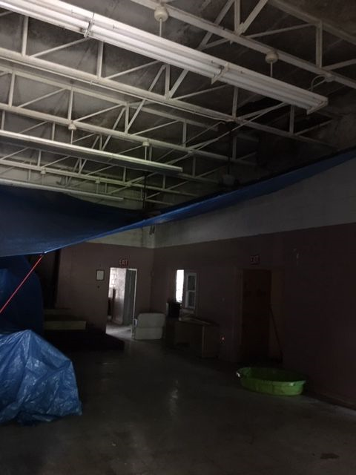
North Campus Damage from EF3 Tornado of January 21, 2017

Slide 5
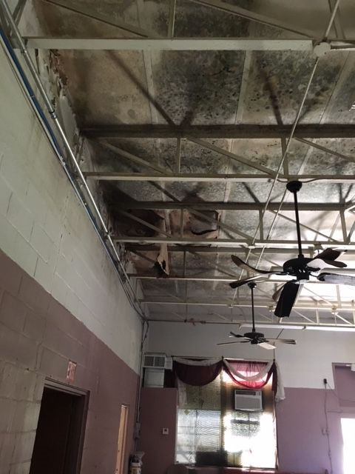
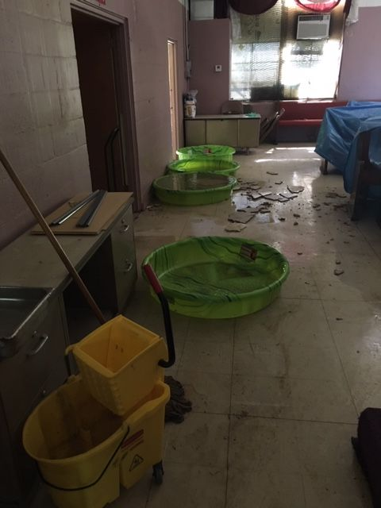
North Campus Damage from EF3 Tornado of January 21, 2017

Slide 6
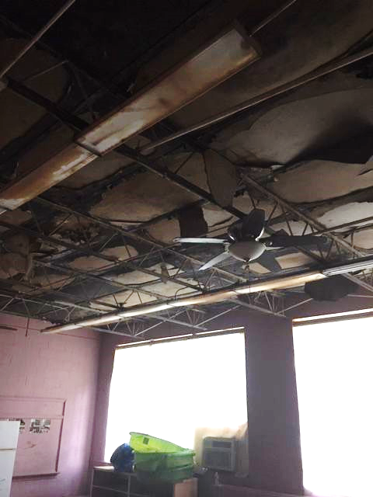
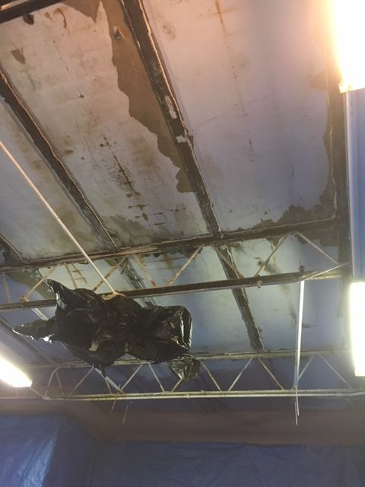
Ceiling Damage in Lunchroom Area of North Campus

Slide 7
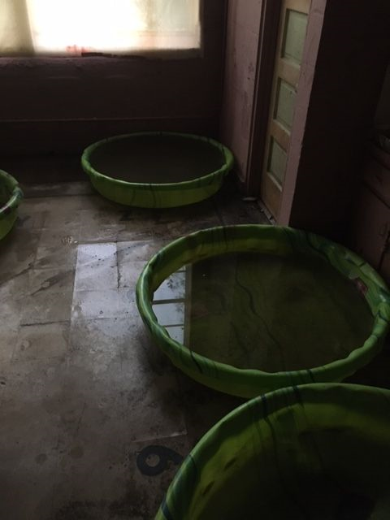
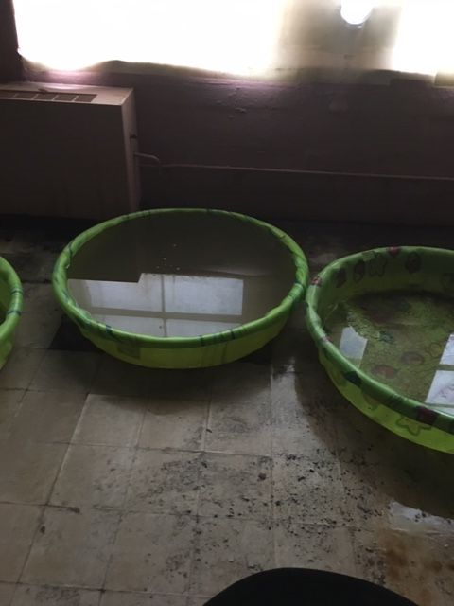
Removal of Water in Lunchroom Area of North Campus

Slide 8
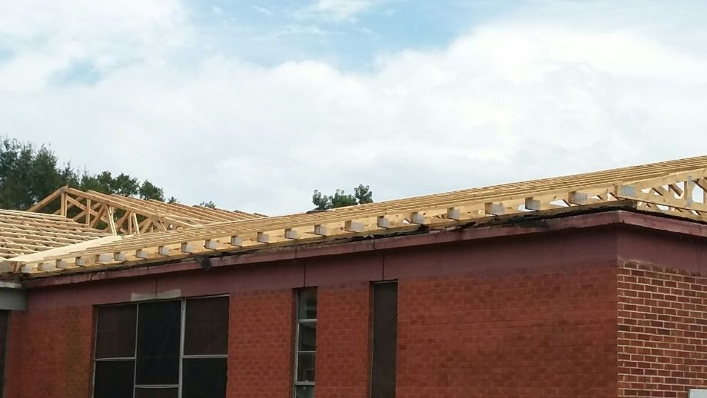
Installation of Roof Trusses on North Campus

Slide 9
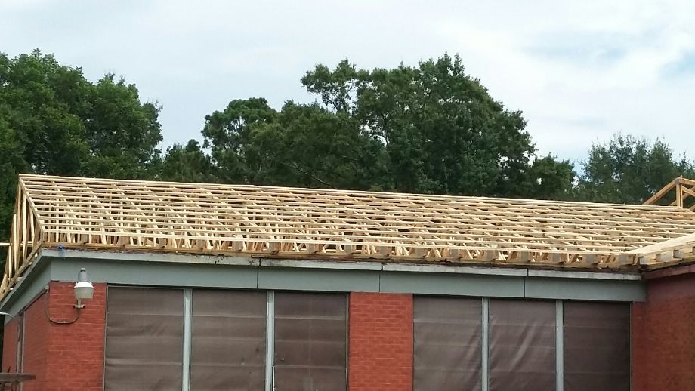
Installation of Roof Trusses on North Campus

Slide 10
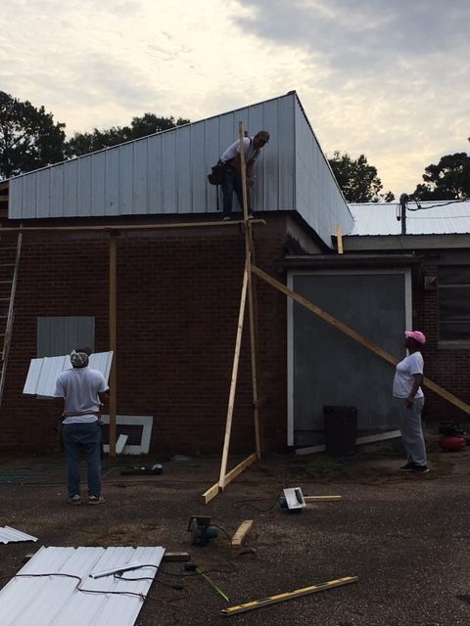
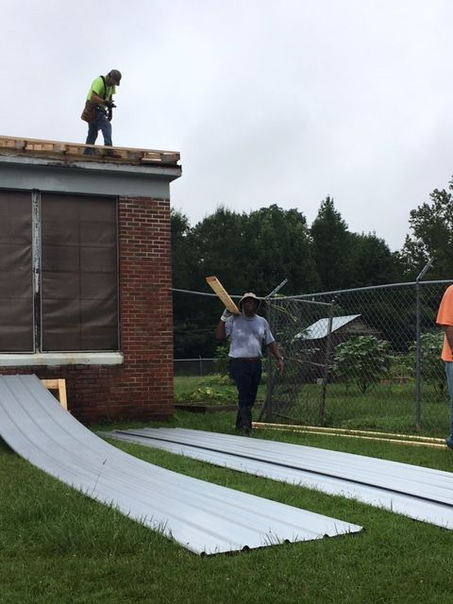
Installation of Metal Roofing on North Campus

Slide 11
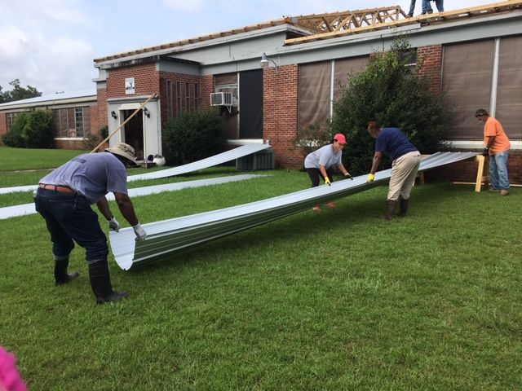
Installation of Metal Roofing on North Campus

Slide 12
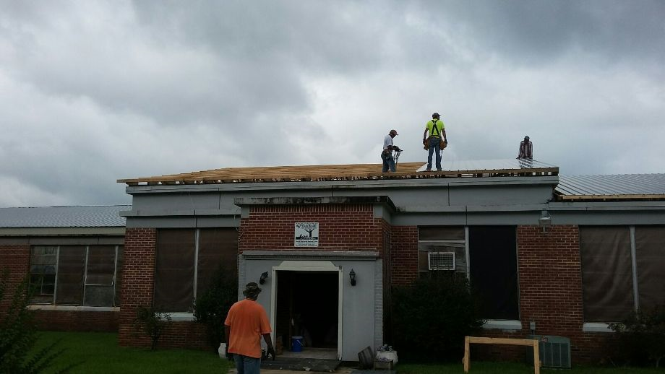

Slide 13
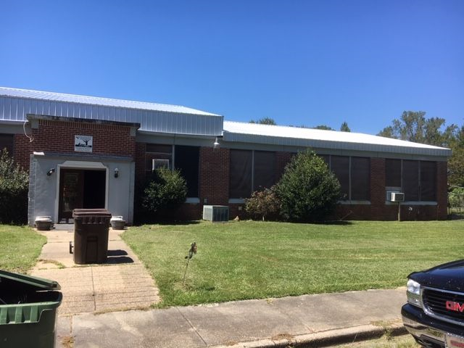
Completion of Metal Roofing on North Campus

Slide 14
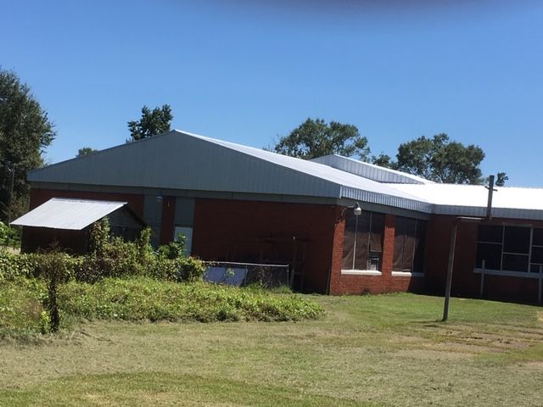
Completion of Metal Roofing on North Campus

Slide 15
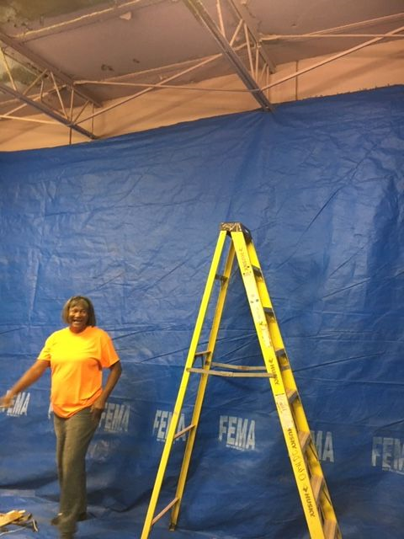
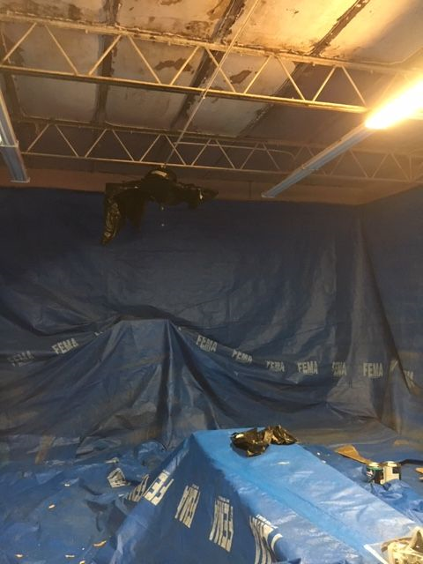
Painting Ceiling in Lunchroom Area of North Campus

Slide 16
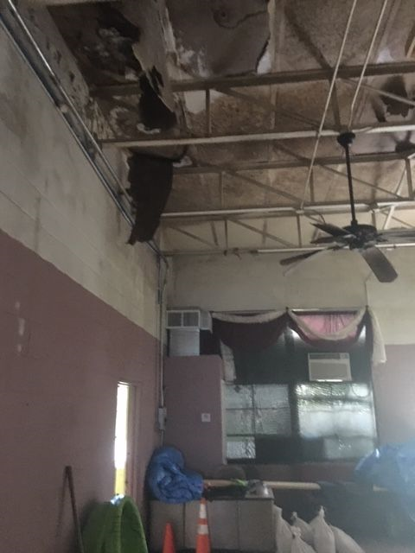
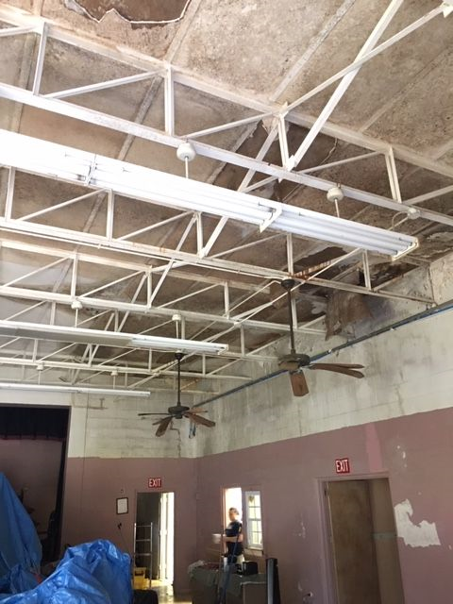
Ceiling Damage in Auditorium Area

Slide 17
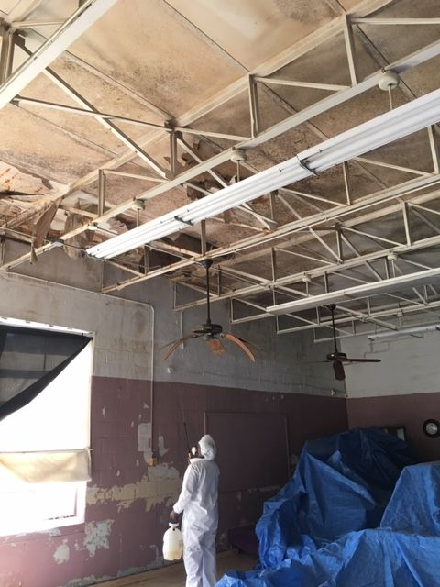
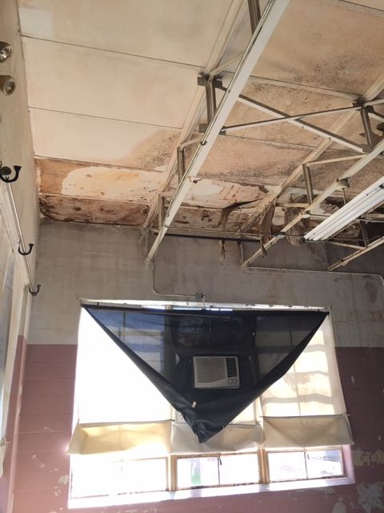
Ceiling Damage in Auditorium Area

Slide 18
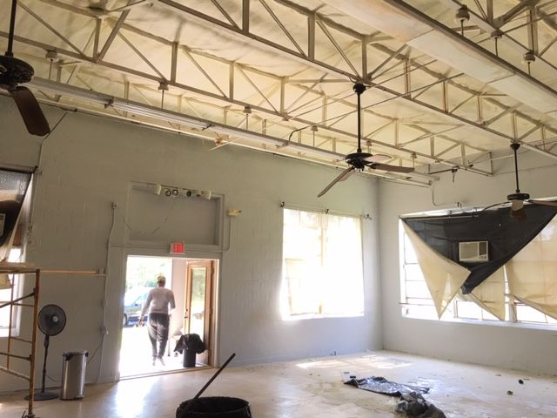
Spray Foam Insulation in Auditorium Area

Slide 19
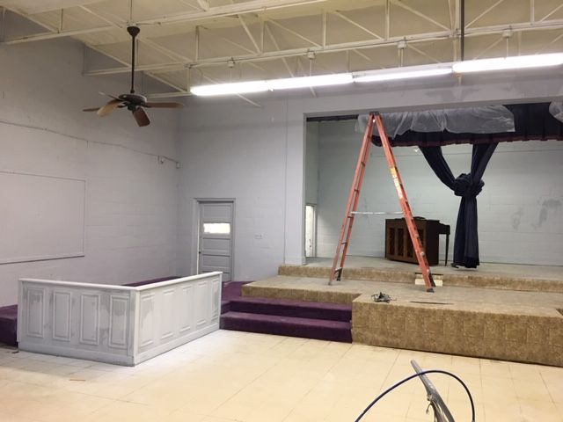
Spray Painting of walls in Auditorium Area

Slide 20
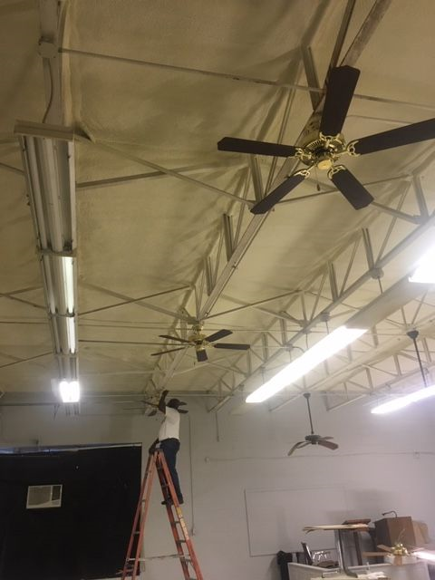
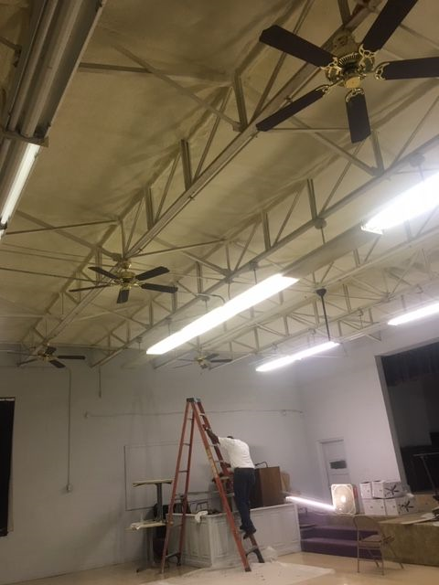
Installation of New Ceiling Fans in Auditorium Area

Slide 21
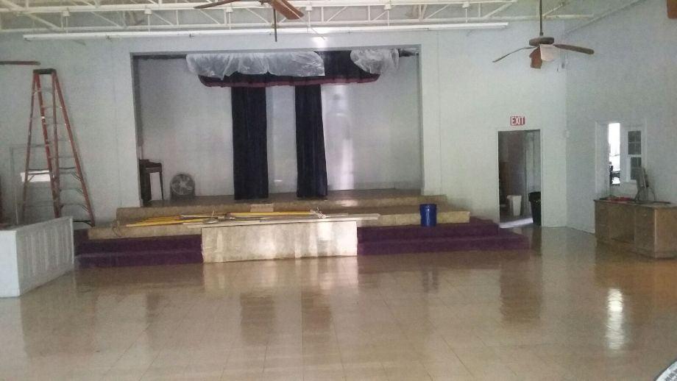
Cleaning and Waxing of Floors in Auditorium Area

Slide 22
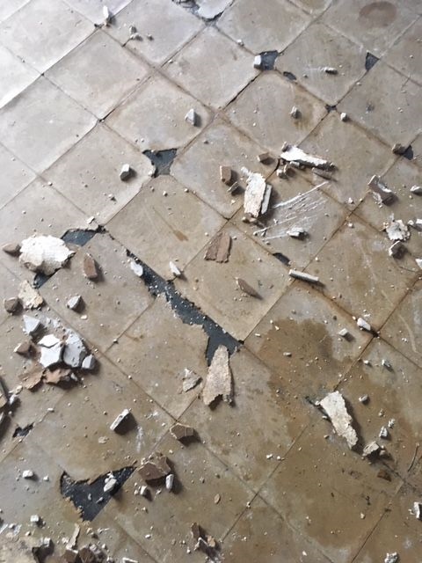
Floor Damage in Lunchroom Area of North Campus

Slide 23
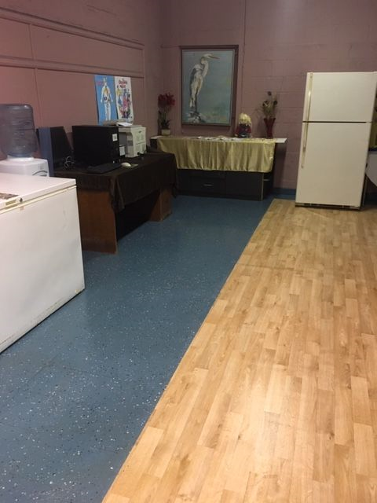
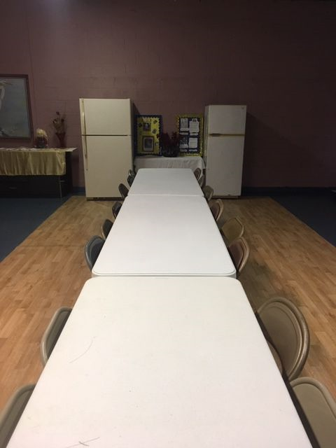
Renovated Work in Lunchroom Area of North Campus

Slide 24
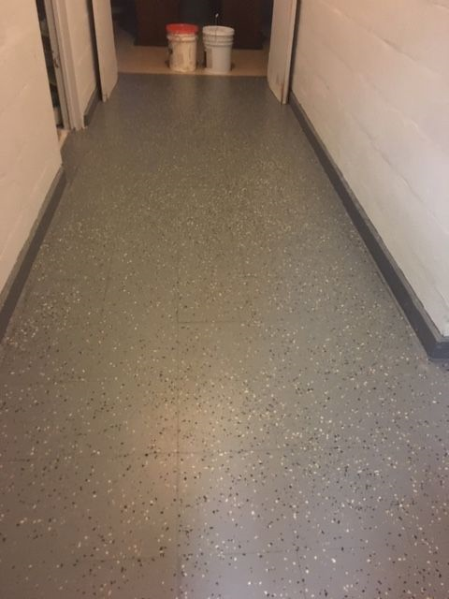
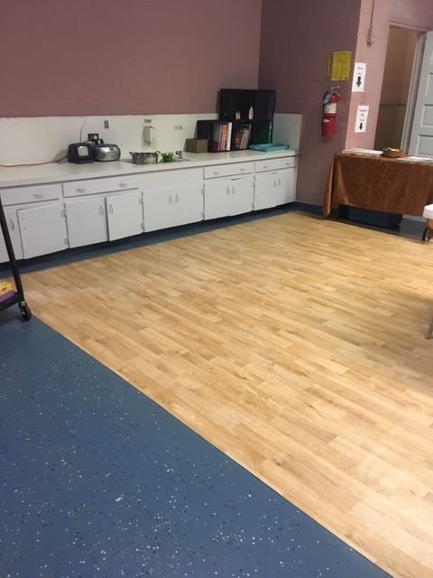
Renovated Work in Lunchroom Area of North Campus

Slide 25
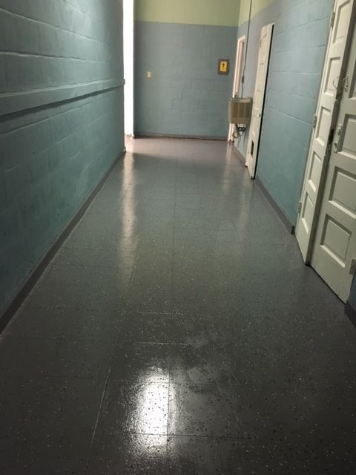
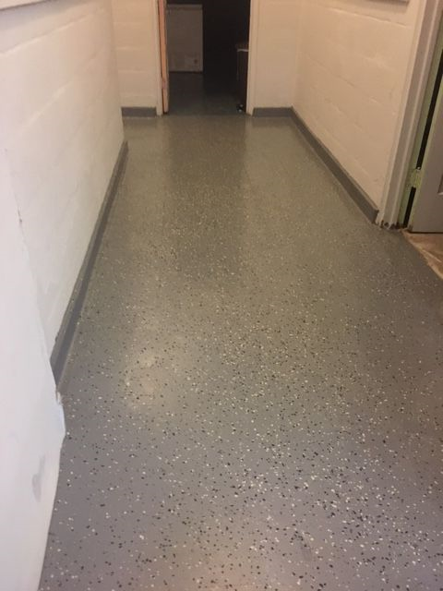
Renovated Floor Work in Hallways of North Campus

Slide 26
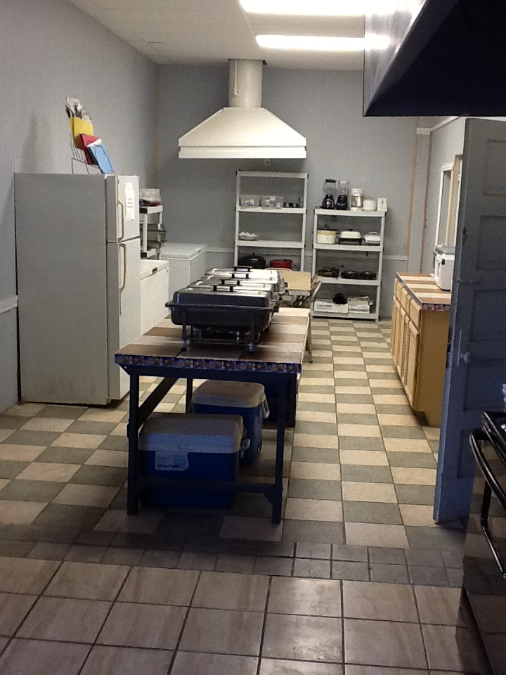
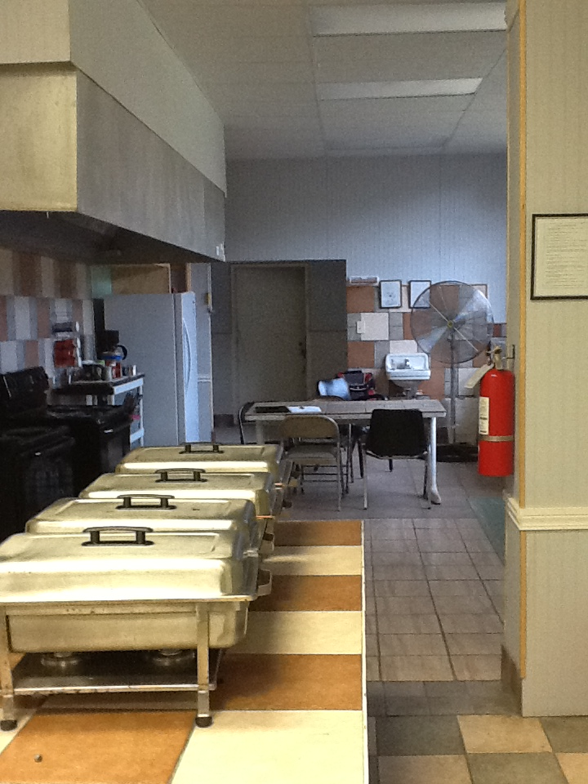
Kitchen Area

Slide 27
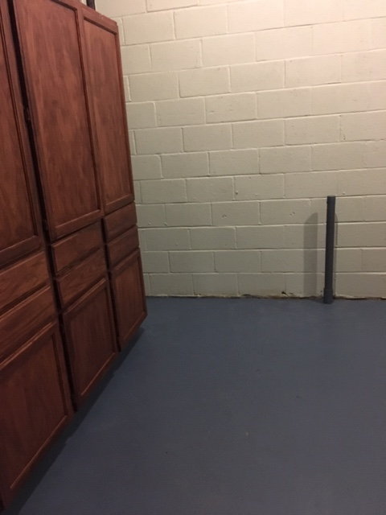
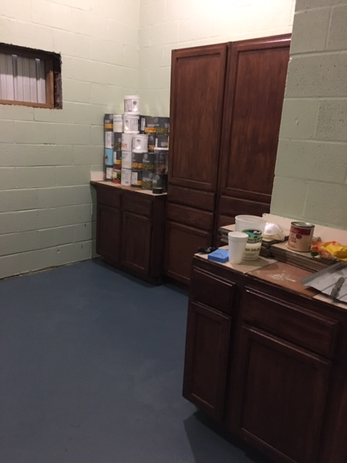
Kitchen Pantry Area

Slide 28
WE SURVIVED….
WE CONQUERED….
WE CONTINUE TO MOVE FORWARD !!!
Galatians 6:9-10 says: ”And let us not be weary in well doing : for in due season we shall reap, if we faint not. As we have therefore opportunity, let us do good unto all men, especially unto them who are of the household of faith.”
1 Corinthians 13:7 says: “Love never gives up, never loses faith, is always hopeful, and endures through every circumstance.”

Slide 29
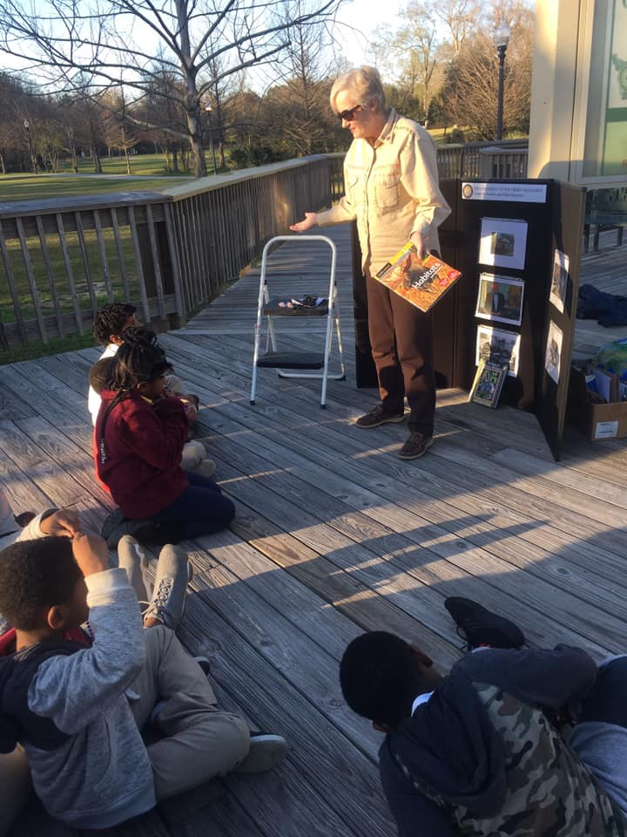
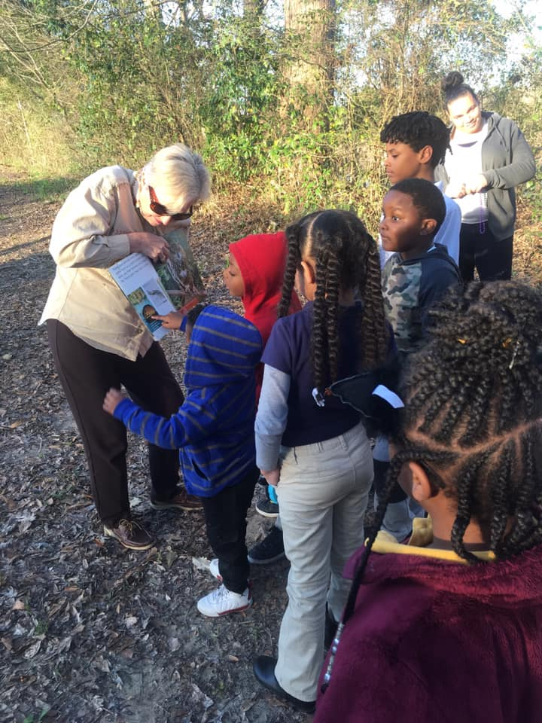
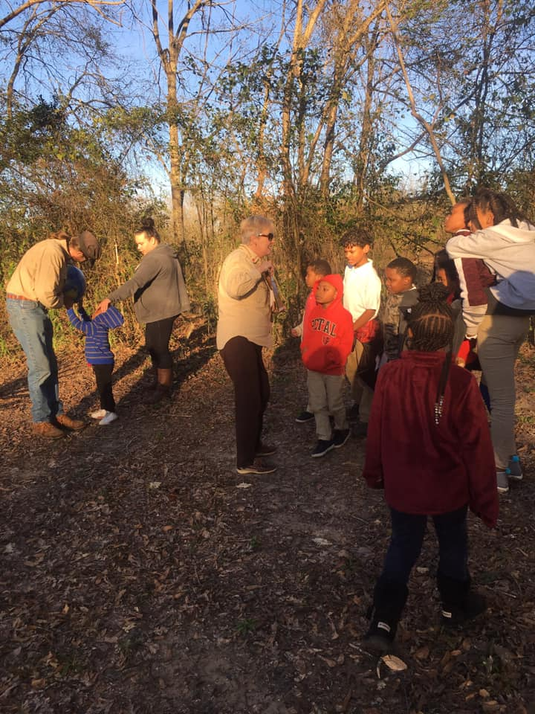
Environmental Adventures at Chain Park – February 2019
What a great learning Environmental adventure and history lesson we had with Dr. Sherry Herron at our own community...Chain Park!! The kids (and we adults) learned a lot about our own community. Thank you so much Dr. Herron for your insight, your time, and your strong desire to educate our community youth!! We look forward to our next learning session!!

Slide 30
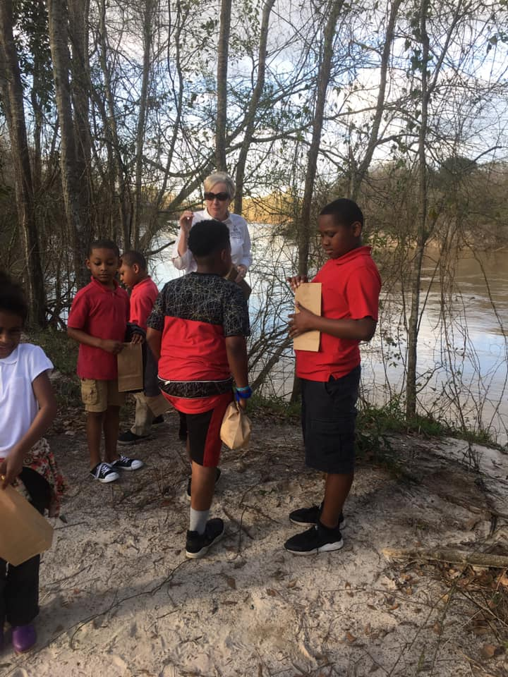
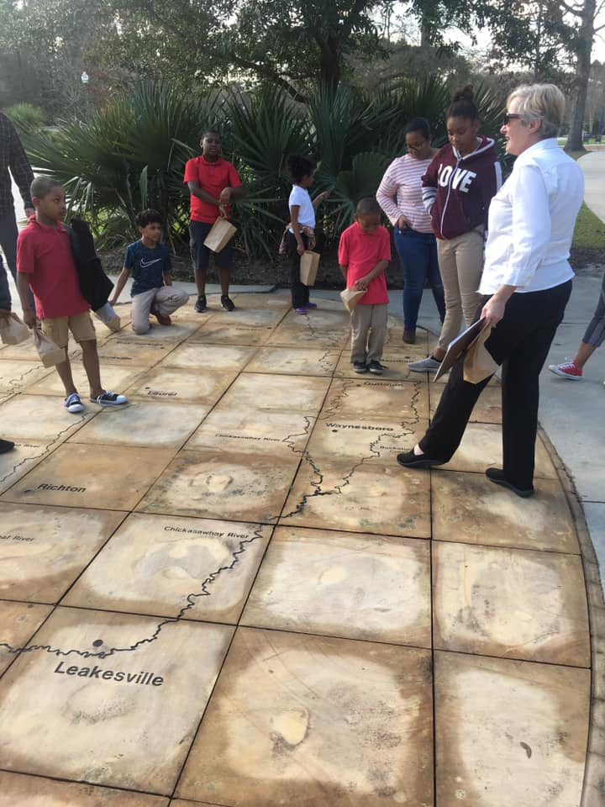
Oh what another wonderful and educational evening at Chain Park at Twin Forks learning about our environment, watershed and all the local rivers, creeks and lakes that runs to our coastal MS sound!! Many thanks again to Dr. Sherry Herron and her team for such a educational event!! It’s truly amazing how much history is right here in our community!!

Slide 31
SUMMER
CAMP
2019
STEAM
CAMP
2019

Slide 32
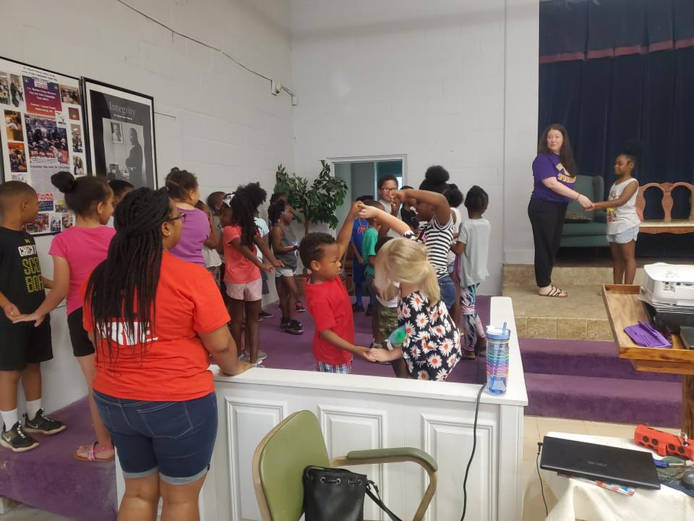
Summer Camp - Dance Class

Slide 33
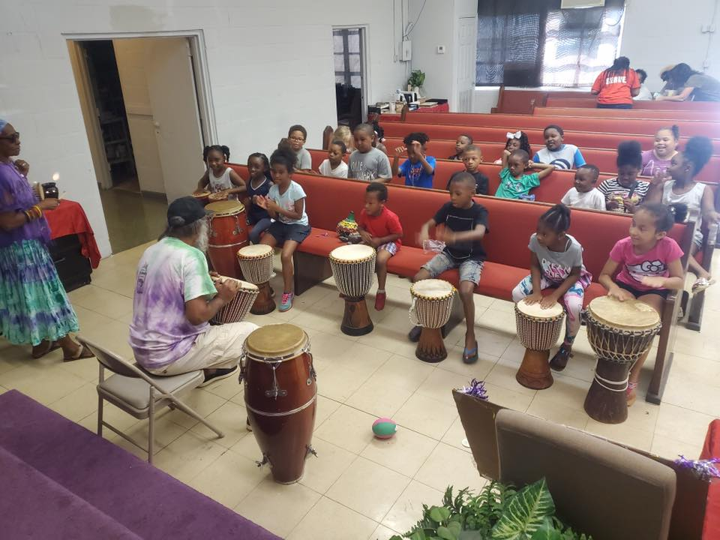
Summer Camp Cultural Sessions with African Drums

Slide 34
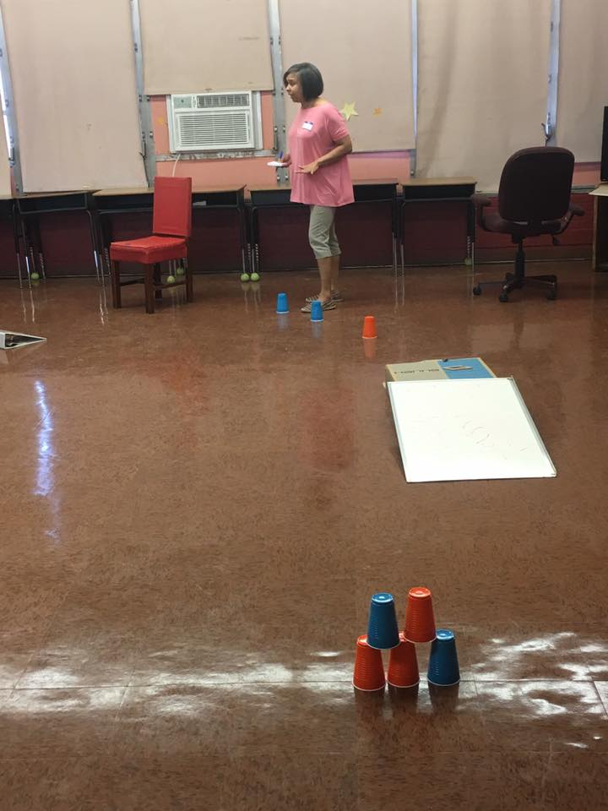
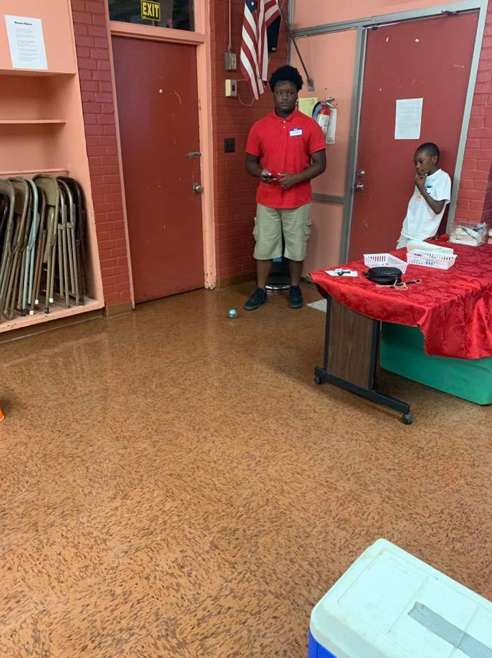
Summer Camp Robotics Class

Slide 35
Summer Camp Fire Safety Training

Slide 36
Summer Camp Fire Safety Training

Slide 37
Praxair / PG Technologies at Howard Technology Park Donation of Food / Snacks for Summer Camp
Praxair / PG Technologies at Howard Technology Park in Ellisville’s management and employees quickly joined this cause by hosting a summer feeding snack food drive for OMYDC! We have partnered with MFN for the past 10 years to provide healthy nutritious meal for our community youth. Many thanks to our friends at Praxair for all your donations of food snacks and summer camp supplies.

Slide 38
Society of St. Andrews
Fresh Fruits and Vegetables Donations
It’s that time of year again that our friends at Society of St. Andrews shared fresh fruits and veggies for our community families. Fresh blueberries!! Cucumbers... Zucchini and Sweet potatoes!! Thank you so so much for your continued support to us...Our community is truly grateful!!

Slide 39
Society of St. Andrews Cereal Donations for the Youth
Thank you so much Society of St. Andrews for once again putting smiles on the faces of our kids as they select their cereal choices!! What a blessing!!

Slide 40
Summer Camp Field Trip to Polymer Science Center at USM
We are truly grateful to Dr. Heather Broadhead, Kim L. Wingo and all the students at USM School of Polymer Science & Engineering for all the fun and educational group learning sessions provided to our 4th-12th graders.
This experience has provided a lasting impression with our students.

Slide 41
Science Experiments with the Youth at USM

Slide 42
Science Experiments with the Youth

Slide 43
United Way of Southeast Mississippi Day of Service Mini-Grant Funding for East Jerusalem Community Garden Project
Our team of volunteers and youth worked extremely hard at the Oseola McCarty Community Garden in spite of all of this South MS HEAT!! Great job!! Many thanks to United Way of SE MS for funding this project for us. A HEALTHY COMMUNITY IS A HAPPY COMMUNITY!!

Slide 44
July Activity - The Church Of Jesus Christ of Latter-day Saints
Everyone can be a SERVANT!! About 100 Youth and their leaders of The Church Of Jesus Christ of Latter-day Saints came to the center today to do just that...SERVE!! We were able to complete work projects in our community garden, help distribute fresh produce for community families, yard work as well as general cleanup of our toy sorting area in preparation for this years Marine Toys for Tots Christmas campaign. We truly love all our volunteers and we know that these work projects could not get completed without their serving hands and caring hearts.

Slide 45
July Activity - The Church Of Jesus Christ of Latter-day Saints

Slide 46
July Activity - The Church Of Jesus Christ of Latter-day Saints

Slide 47
July Activity - The Church Of Jesus Christ of Latter-day Saints

Slide 48
New Project
Sponsor Site for AmeriCorps VISTA

Slide 49
We Need Your Help!!
Upcoming Project
15th Annual Operation Christmas SLEEVE 2019
“Toy Drive” Drop sites

Slide 50
Oseola McCarty Youth Development Center
Volunteers Needed For Literacy Project
K-12th Grades
Help needed for After school class sessions
and Field trips!!
Volunteers Needed for Healthy Futures and
Community Garden Project
Volunteers Needed for Soft Skills Training for
High School Students
Be a Mentor…. Volunteer…
Make a Difference with Our Youth !!
Please Contact:
Janet Baldwin @ 601-520-0657
Volunteers Are Our Super Stars!!
We Need Your Help!!
Address: 607 McSwain Street – Hattiesburg
Center Telephone: 601-336-7940 or
Cell Phone: 601-520-0657

